Slide 1



KONGU ENGINEERING COLLEGE
DEPARTMENT OF ARTIFICIAL INTELLIGENCE AND
DATA SCIENCE
HCL PROJECT
IT HELPDESK AUTOMATION ASSISTANT
Project Members:
ENIYA C(24ADR044) ATHISH V P(24ADR013)
DHARSHAN S(24ADR035)
Notes:
8 September 2023
1-59
1

Slide 2


PROBLEM STATEMENT
Manual IT helpdesk support increases workload and response time
Employees face delays in resolving common technical issues
Large number of support tickets creates backlog problems
Traditional support systems require continuous human intervention
Lack of instant troubleshooting support reduces productivity
Need for an AI-based automated helpdesk solution for efficient issue handling
Notes:
2

Slide 3
LITERATURE SURVEY
JOURNAL | YEAR | DESCRIPTION | METHODOLOGY | LIMITATIONS
Retrieval-Augmented Generation for Knowledge-Intensive NLP Tasks | 2020 | Introduced RAG to combine retrieval with text generation for knowledge-based answers | Dense retrieval + Seq2Seq generation | Needs quality documents and retrieval setup
Automating Customer Service using LangChain | 2023 | Builds custom chatbot for organization support automation | Open-source LLM + embeddings + retrieval | Requires domain-specific data
A Generative AI-Based Chatbot Builder for Question Answering | 2025 | Creates QA chatbot using LLMs such as LLaMA-3 | LLM + instruction tuning + RAG | Needs tuning for accurate responses
Notes:
2

Slide 4
OBJECTIVES
To develop an AI-powered IT Helpdesk Assistant using LLaMA
To provide instant responses for common technical issues
To reduce IT support workload and ticket backlog
To automate troubleshooting and issue handling
To improve response time and user experience
To create an efficient conversational support system using Ollama and
Flask(python)
Notes:
2

Slide 5
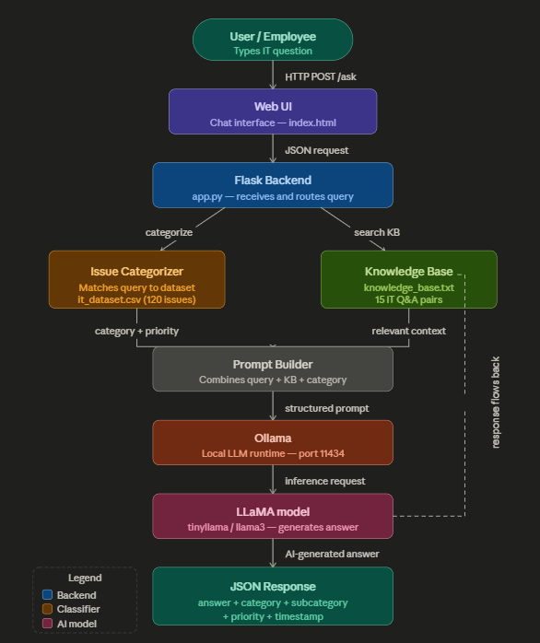
METHODOLOGY
Notes:
2

Slide 6
PROPOSED WORK
Develop an AI-based IT Helpdesk Assistant using LLaMA and Ollama
Create an interactive chatbot interface for user communication
Process and analyze user technical queries in real time
Generate intelligent troubleshooting responses using LLM
Automate common IT support tasks and issue handling
Improve response efficiency and reduce manual support workload
Notes:
2

Slide 7
MODULES
The Backend Server Module handles requests and responses.
The Query Processing Module receives user technical issues
The User Interface Module helps users interact with the chatbot
The AI Response Generation Module generates answers using the LLaMA model.
The Communication Module transfers data between frontend and backend.
The Output Module displays troubleshooting solutions to users.
Notes:
2

Slide 8
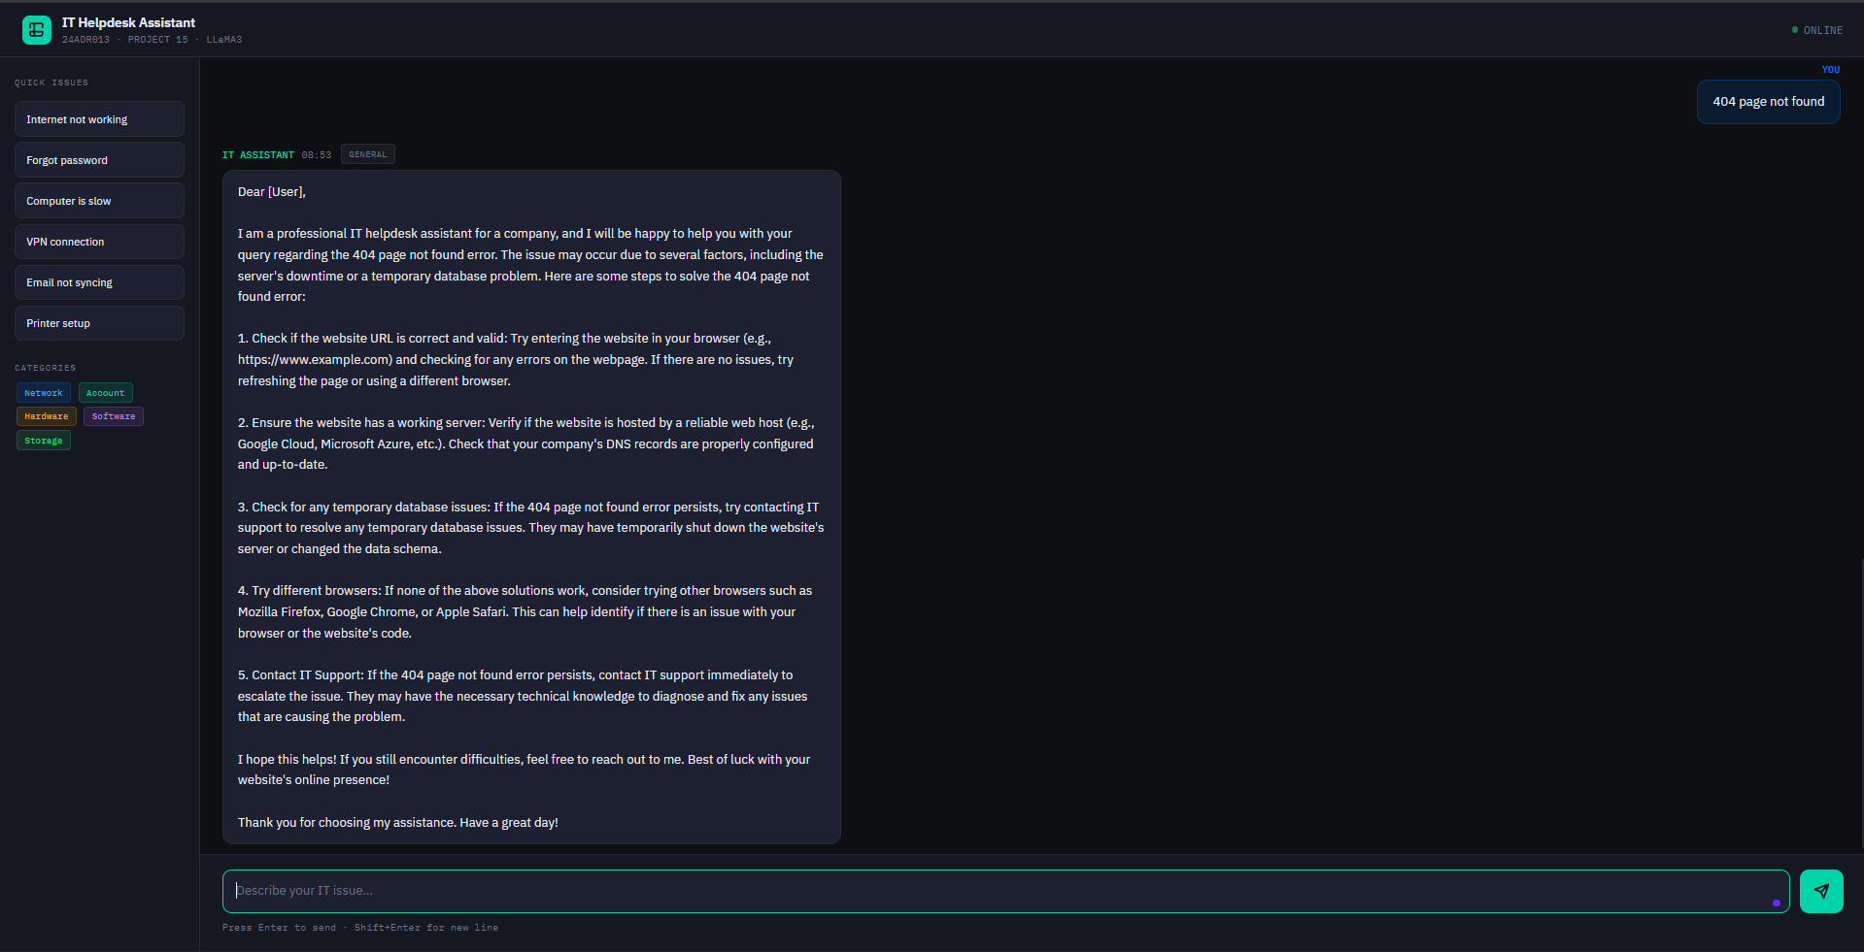
DEMO SCREENSHOT
Notes:
2

Slide 9
RESULTS ACHIEVED
Successfully generated AI-based responses for technical queries
Reduced dependency on manual IT support for common issues
Achieved faster troubleshooting assistance using LLaMA
Improved user interaction through conversational interface
Successfully integrated frontend and Ollama LLM system
Demonstrated efficient real-time chatbot communication
Notes:
2

Slide 10
CONCLUSION
The proposed IT Helpdesk Assistant successfully automates technical support using LLaMA-based AI
The system provides quick and intelligent responses for user queries
It helps reduce manual workload and IT ticket backlog
The chatbot improves troubleshooting efficiency and user experience
Ollama and Node.js enable simple and effective local deployment
Notes:
2

Slide 11
REFERENCES
MetaAI(2023) LLaMA: Open and Efficient Foundation Language Models Available: https://ai.meta.com/llama/
Ollama Documentation Running Large Language Models Locally Available: https://ollama.com/
FastAPI Documentation FastAPI Framework for Building APIs Available: https://fastapi.tiangolo.com/
ChromaDB Documentation Vector Database for AI Applications Available: https://www.trychroma.com/
Notes:
2

Slide 12
Thank You
Notes:
2

